Slide 1


WEB DEVELOPMENT
Deivanai . S
24524U18020
Karan arts and science college

Slide 2
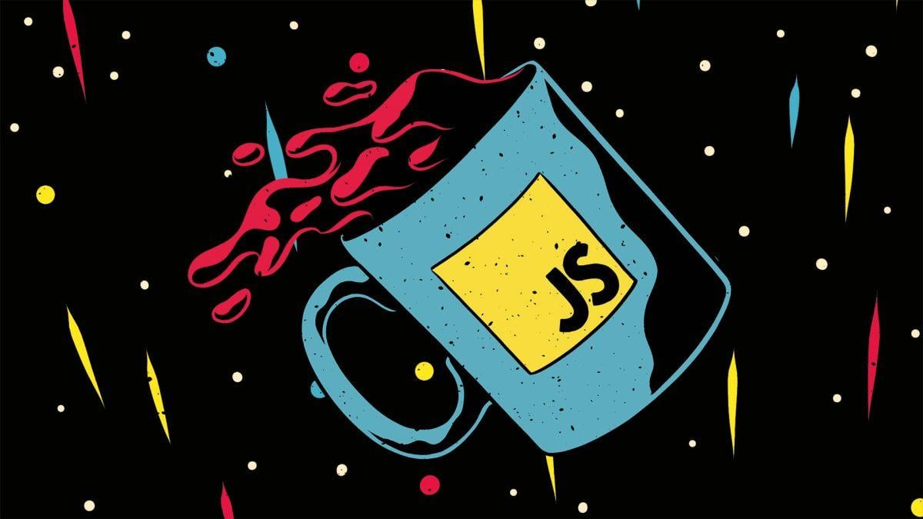
INTRODUCTION TO WEB DEVELOPMENT
HTML, CSS, and JavaScript are the core technologies used to create all websites and web applications.
They work together, each with a specific role, to build the interactive and dynamic web pages we use every day.

Slide 3

HTML INTRODUCTION HTML is the standard markup language for creating web pages. It's not a programming language; it uses tags to define the structure and content of a web page. These tags instruct a web browser on how to display the content. Markup Language: A system for annotating a document to distinguish between content and how that content should be displayed.

Slide 4
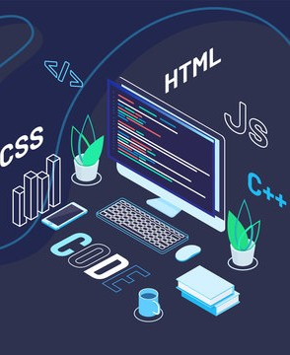
KEY HTML CONCEPTS
Tags are keywords enclosed in angle brackets, like <p> for a paragraph. Elements are composed of an opening tag, content, and a closing tag (e.g., <p>This is a paragraph. </p> ). Attributes: Provide additional information about an element, such as src for an image or href for a link. Example: <ahref="https://www.google.com">Google</a> Document Structure: Every HTML page has a basic structure defined by the <!DOCTYPE htm1>, <htm1> <head>, and <body> tags.

Slide 5
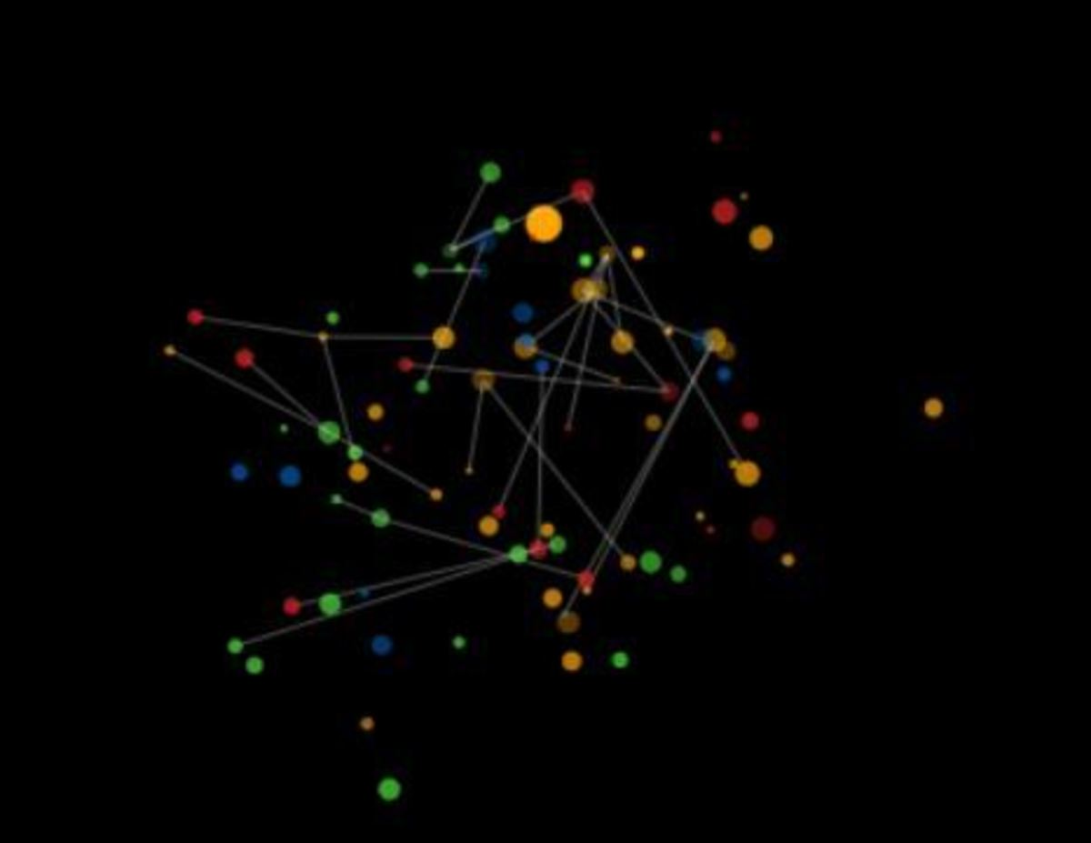
HTML FEATURES & TAG
Headings: <h1> to <h6> for different levels of titles. Paragraphs: <p> for blocks of text. Links: <a> to create hyperlinks to other pages or resources. Images: <img> to embed images. Lists: <ul> (unordered) and <ol> (ordered) for creating lists. Tables: <table> to display data in a structured way

Slide 6

Foundation of the Web: It's the essential building block for every website. Easy to Learn: The syntax is simple and intuitive, making it a great starting point for beginners. SEO-Friendly: Properly structured HTML helps search engines like Google understand and rank your content. Free and Open Source: It's a non-proprietary standard, accessible to everyone
HTML IMPORTANT

Slide 7
A SIMPLE HTML PAGE
<!DOCTYPE html>
<html>
<head>
<title>My First Web Page</title>
</head>
<body>
<h1>Welcome to my website!</h1>
<p>This is a paragraph of text.</p>
<a href="https://www.w3schools.com">Visit W3Schools</a>
</body>
</html>
Explanation: This code creates a basic web page with a title, a main heading, a paragraph, and a link.

Slide 8
CSS INTRODUCTION
WHAT IS CSS ?
CSS is a style sheet language used to describe the presentation of a document written in HTML.
It controls how the HTML elements are displayed on the screen.
It handles the colors, fonts, layout, and spacing of your web content.
Cascading: This refers to the way styles are applied, with more specific rules overriding general ones

Slide 9
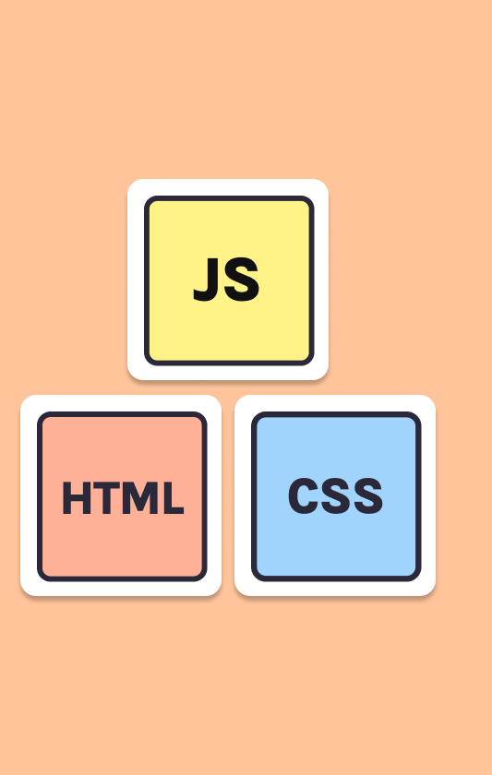
KEY CSS CONCEPTS
Selectors: Patterns used to select the HTML elements you want to style.
Examples: p (selects all paragraphs), #header (selects an element with id="header" ), .info (selects elements with class="info" ).
Properties and Values: The styles you want to apply.
Example: color: blue; (the property is color and the value is blue ).
Ruleset: A combination of a selector and a declaration block (the property-value pairs).

Slide 10

FEATURES OF CSS
Styling Text: Change fonts, sizes, colors, and add text decorations. Layout and Positioning: Control the arrangement of elements on a page using Flexbox or Grid. Backgrounds and Borders: Add background images, colors, and customize element borders. Responsiveness: Use media queries to adapt a website's layout for different screen sizes (e.g., mobile, tablet, desktop).

Slide 11
ADVANTAGES OF CSS
Separation of Concerns: It separates the content (HTML) from the style (CSS), making the code cleaner and easier to manage.
Efficiency: You can apply the same style rules to multiple pages from a single CSS file.
Consistency: Ensures a uniform look and feel across your entire website.
Better User Experience: Well-designed pages are more visually appealing and easier to read.

Slide 12
CSS EXAMPLE STYLING WITH CSS
body {
font-family: Arial, sans-serif;
background-color: #f0f0f0;
}
h1 {
color: #333;
text-align: center;}
p {
line-height: 1.6;
}

Slide 13

INTRODUCTION TO JAVASCRIPT
JavaScript (JS) is a programming language that brings websites to life.
It allows you to create interactive and dynamic effects on a web page.
It runs directly in the web browser, on the user's device.
It's responsible for the "behavior" of a website

Slide 14

JAVASCRIPT FEATURES
User Interactions: Handle clicks, form submissions, and other user events.
Animations: Create simple or complex animations without refreshing the page.
Dynamic Content: Update parts of a page without a full reload, for example, fetching new data from a server.
Form Validation: Ensure user input is valid before it's submitted.
APIs: Use APIs (Application Programming Interfaces) to interact with other services, like Google Maps or social media.

Slide 15
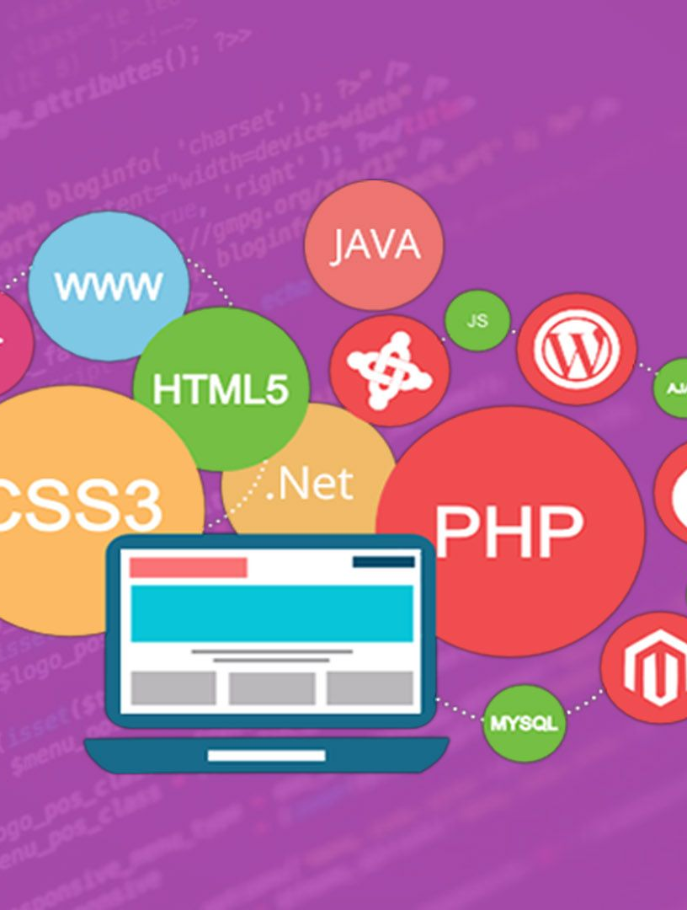
Advantages of JavaScript
Interactivity: Creates engaging and user-friendly websites.
Speed: Since it runs on the client's browser, it doesn't require a server request for every interaction, making the page faster.
Versatility: Used for frontend, backend (with Node.js), and mobile development.
Large Community: A huge community and a vast collection of libraries and frameworks (like React, Angular, and Vue.js) make development easier

Slide 16
Javascript Example
function greetUser()
{
let name = prompt("Please enter your name:");
if (name) {
alert("Hello, " + name + "! Welcome.");
}
}

Slide 17
The Web Development Workflow
HTML: Provides the core structure of the page (e.g., a headline, a paragraph, an image).
CSS: Styles the structured content (e.g., makes the headline red, centers the paragraph, and adds a border to the image).
JavaScript: Adds behavior and interactivity (e.g., when you click the image, a pop-up appears).

Slide 18
Conclusion
HTML is the skeleton.
CSS is the skin and clothes.
JavaScript is the nervous system and muscles.
Together, they form the foundation of the modern web.

Slide 19

Thank you

